Slide 1

Work For Me App
By: Jonathan, Sean, Malene, Hadia, and Chris

Slide 2
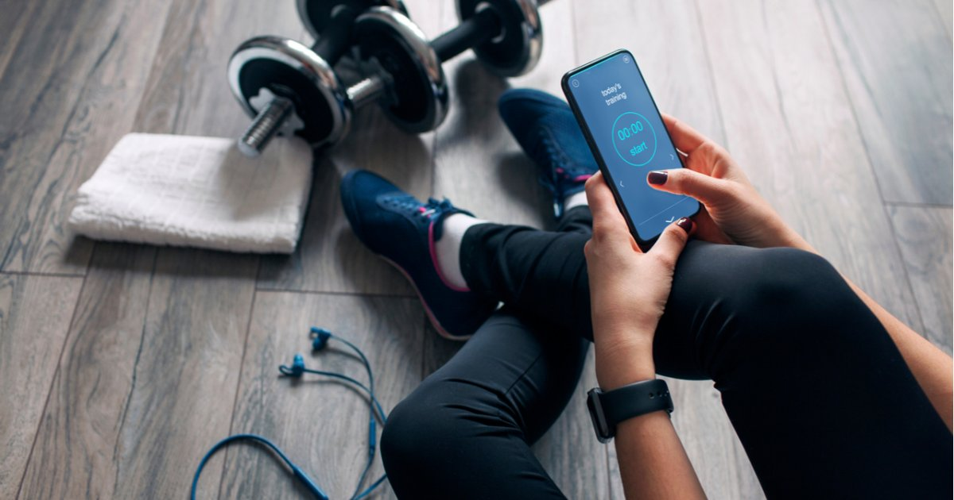
What Does This App Aim To Do?
Eliminate the heavy costs that come with using personal trainer, but still providing that same personal touch to one’s workout routine. In addition to these workouts, the app will provide nutrition guides and recipes that accommodates not only to the workout; but also the user’s personal taste and preference. Using the app to create a personalized profile that takes away the toiling hardship of researching and leave everything to the app.

Slide 3
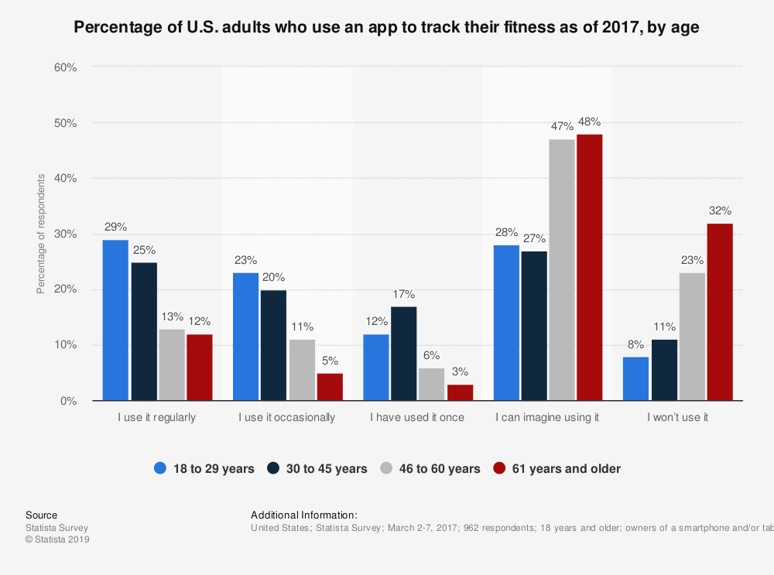
The Target Audience
Our app is targeted towards the age group of 18 to 29 years old. Especially teenagers since they use their phones and electronics a lot now in today’s age. People from this age group are shown that they would use fitness based apps compared to those from ages 61 years or older. Statistics in a study from 2017 by Alexander Kunst that most people from this age group use fitness and health-based apps regularly compared to those who are older.

Slide 4

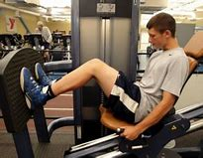
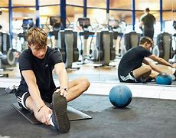
Why do they use these Fitness and Health Apps?
A percentage study from 2014 by Statista Research Department has shown that the reason people from this age group would like to use these app is for goal tracking, awareness of health issues, motivation, identifying unhealthy habits, medication adherence, connecting with an expert, and competition. Goal tracking is the highest percentage reason. This would make a lot of sense because people from this age group have many goals that they would want to accomplish since they are still young and in their prime.

Slide 5


What are they Buying:
For our target audience they usually spend more of their money on fitness compared to colleges.
In a study from 2018 by Jeanette Settembre, The age group of 18 to 65 spends about $155 per month on health and fitness.
Most of these expense costs would be on gym memberships, health supplements, clothing and accessories for workouts, healthy meal plans, and trainers.
The total cost of this would be about $13,000 more than a public four-year college education which would total to $98,440.

Slide 6
Research & development
(we will need a big number of research, development and tech expertise)
Where we need the most amount of skills and where we will be doing a lot of the research would be creating the personalized profile for each member that joins. This step in the process is going to need the most amount of time and work because we want to make sure every member is placed in the correct fitness plan because other than that the plan wouldn’t be beneficial to them. Sitting around a table with fitness experts and nutritionist in order to come up with hundreds of fitness plans will need a lot of skills, research and development.

Slide 7

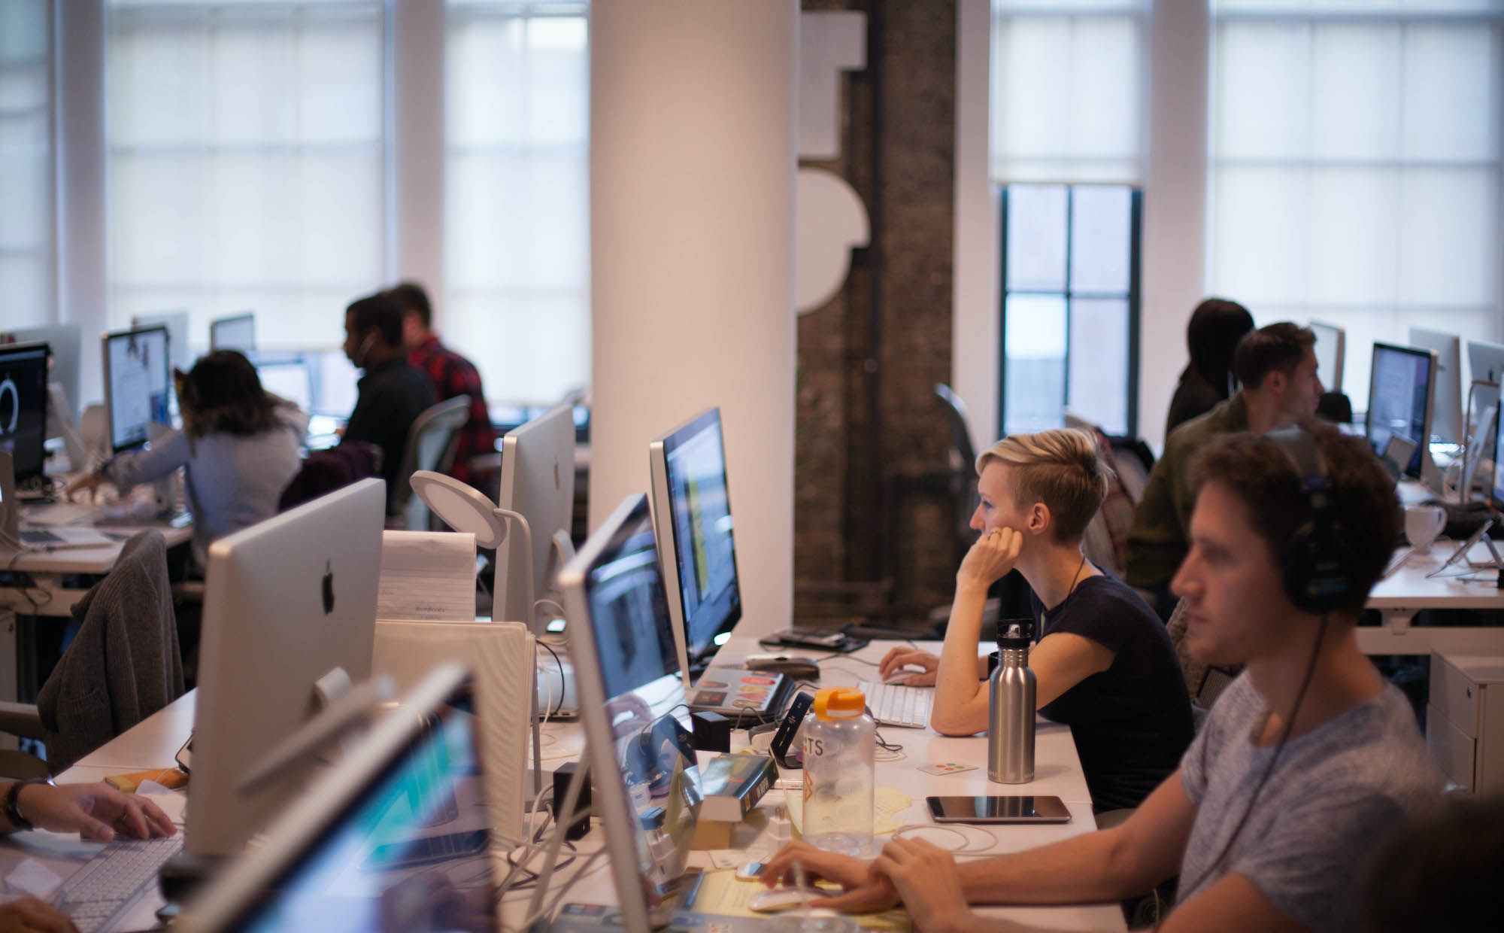
How & who runs the app ?
CEO meets up with the four assistance on specific days to come up with ideas on improving the app for increase in revenue.
On opposite days assistance will be side by side with employees in order to successfully improve ideas the CEO stated in the previous meeting.

Slide 8



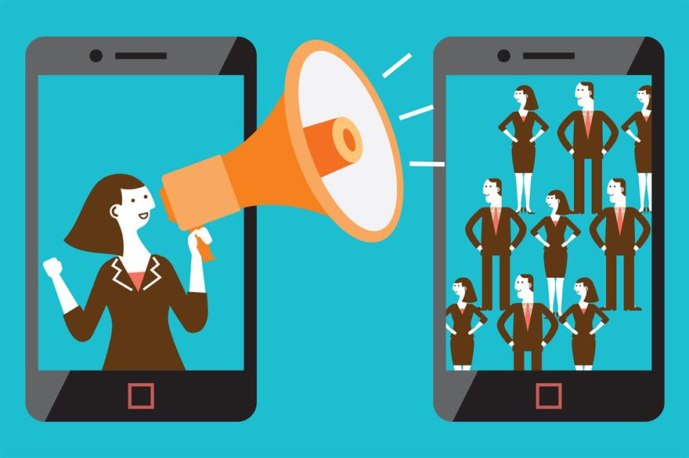
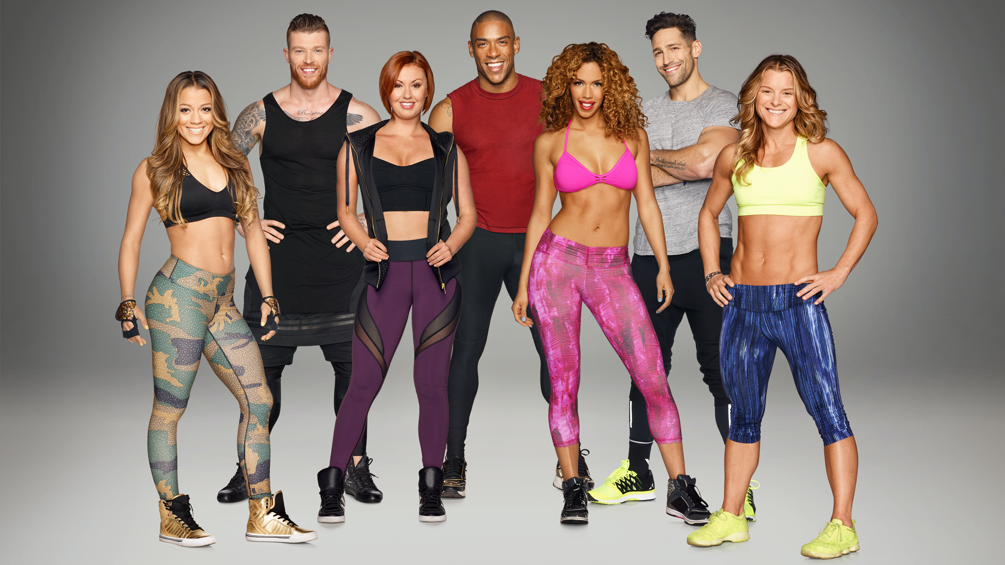

MEET OUR TEAM:
Digital media technicians
(Creating the app & fixing anything that has to do with the app also responsible for the fitness quiz)
Social media managers
Advertisers
(Advertising the app on all social media platforms getting people from all over the world to join )
Fitness expert
Nutritionist
(Creating exercises plans & programs , giving advice .. creating diet plans for each member that wants to join the diet section of the app)

Slide 9
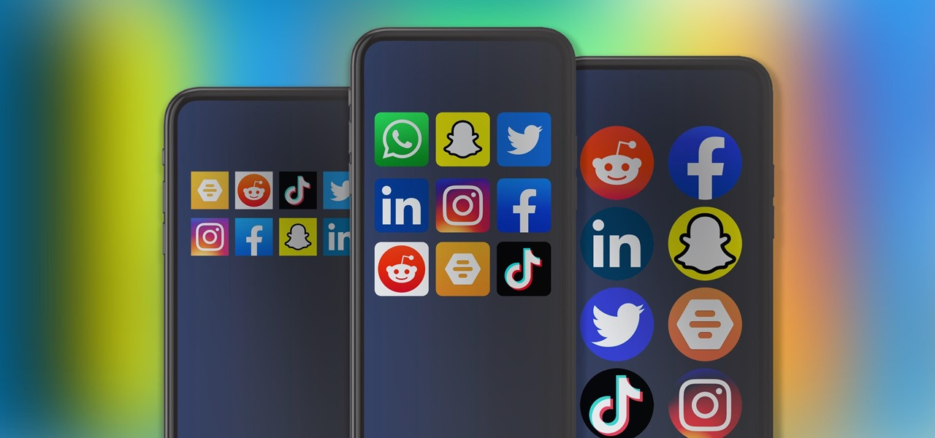
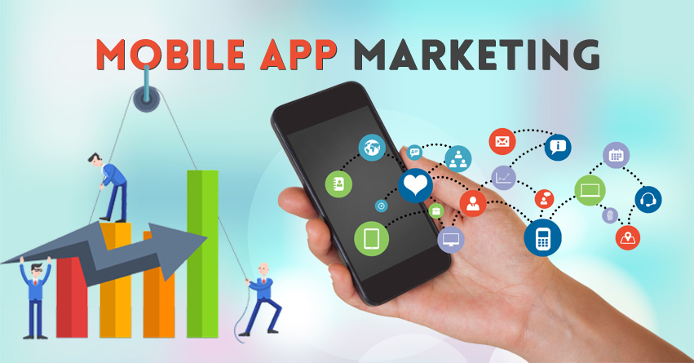
Marketing & Promoting Strategies:
Get in Touch
Leverage your Mobile Website
Feature the app in an Official Blog
Reach out to Google’s search engine
Join developer and entrepreneur groups on social media

Slide 10
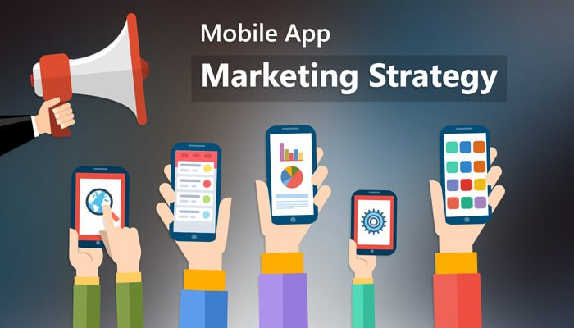
Strategies Explained:
You can reach out to your customers by talking to them and including them in the process, you’re not only promoting your app, but you are making sure that the app you make fits the people you are catering to
A website that is fully functional can help anyone that is interested in your company, they will find their way to your website by seeing a pop-up page display whenever they visit your site to know to download the app
Creating a blog post solely about your app or including a call to action at the end of every post to invite your viewers to download the app and with a complete story about it which lets your target audience know the purpose behind it
Google’s search engine focuses on results from high authority blogs that you can contact to get your app featured as it offers long-term benefits such as: exposure, targeted traffic, powerful link-building, rating & reviews
Social media groups such as; LinkedIn, Google+ and Facebook, can be used to chat with entrepreneurs & app developers to ask for their feedback on your app and you could give them free promo codes to try it out to see how it is to promote it

Slide 11
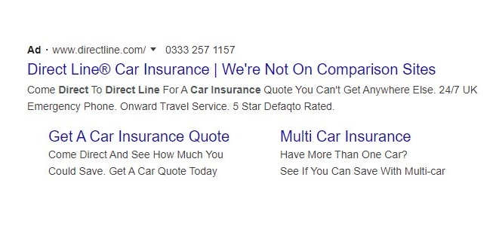


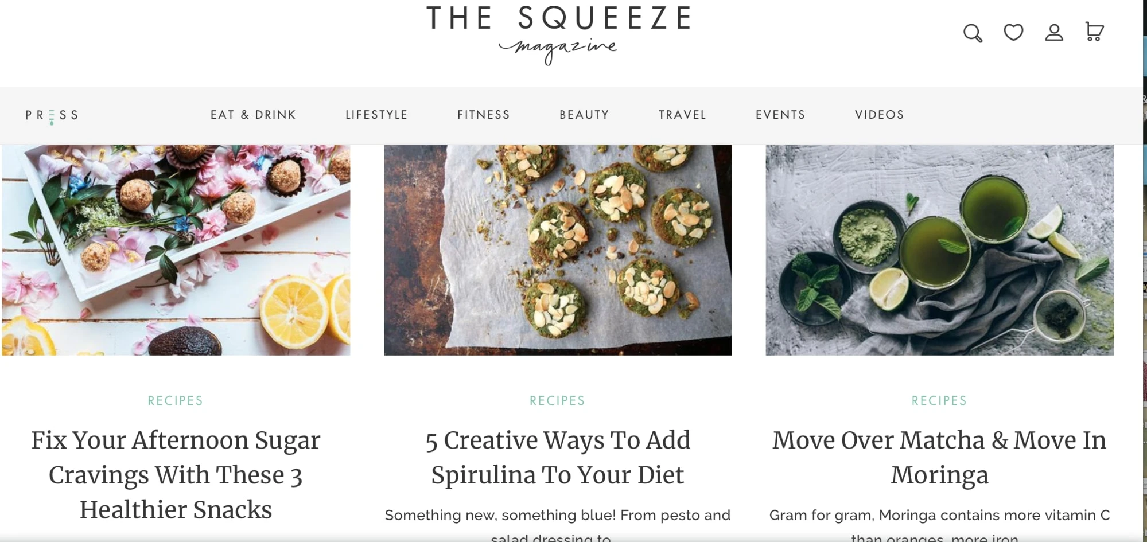
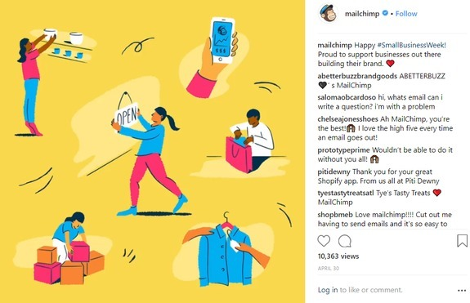
Examples from other Marketing Campaigns:
A brand named MailChimp regularly posted lighthearted content to show their customer base that they care about them
The VSCO app had a video ad for Instagram that showcased how to use the editing app to add filters on photos
A blog named Squeeze Magazine sells cold-pressed juices, healthy living is a big focus for them and for their audience
An insurance ad named Direct Line is not offered on any price comparison websites making it an easier selling point for the ad
Gold’s Gym uses a Facebook group to create a community where members can share their progress on their challenges, seek motivation, and to document their own journey

Slide 12
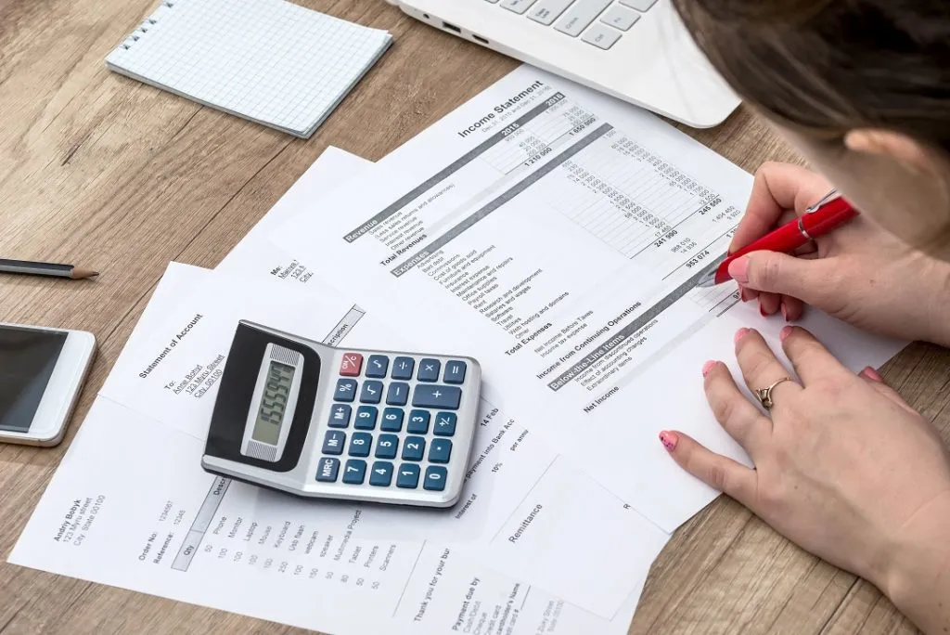
Cost of Production
In order to financially support this app we need to take into consideration the expenses and long term updates
Hiring software engineers to design, integrate social media platforms and implement updates takes many hours of production. With an average rate of US engineers of $75 an hour, and a production time of 1075 hours, we calculate an initial cost of $80,625
This cost will include features such as goal tracking, new and updated workouts, calorie counting,educational content and many more
Adding new content will vary in price depending on production time

Slide 13
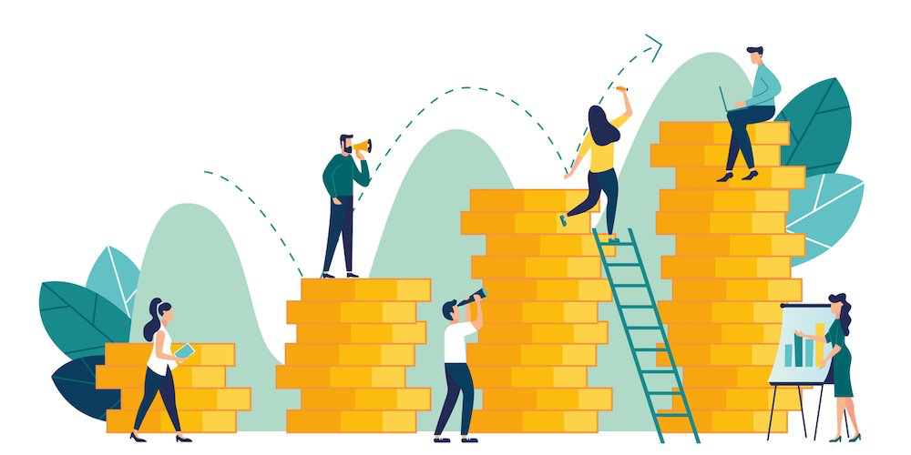
How will we generate revenue ?
Now that we discussed the cost, let’s address the money making strategy !
In order to obtain access to the app, there will be a monthly rate of $40.If we average approximately 100 new members a month it would put us on track to break even in 2.5 years. This is less than the average time it takes for a business to be net positive. To further expand the apps target Audience, we will be offering it to IOS and Android devices.
In order to achieve this goal, we seek a $30,000 investment in exchange for 5% stake in our Company.

Slide 14
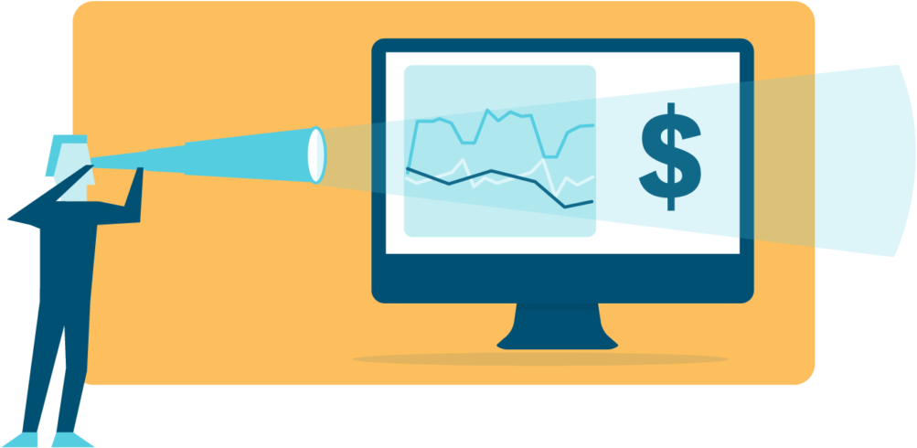
What are the future plans...
As the app develops from its original stages, we plan to market and advertise more to include partnerships with athletic brands and social media influencers. We will strive to provide the most advanced and qualified system of exercise to enable the user to reach his or her goals without any doubt.
We will consistently update the app and add exercise for all levels of fitness. We will ensure to provide the best customer service as we take all feedback serious. In order for the app to work for you, it has to work for me

Slide 15
Works Cited
https://buildfire.com/free-app-promotion/
https://www.copper.com/resources/customer-marketing
https://www.blog.udonis.co/mobile-marketing/mobile-marketing-and-social-media
https://www.shopify.com/blog/blog-examples
https://ppcprotect.com/google-ad-examples/
https://blog.hubspot.com/marketing/best-facebook-groups-examples
https://www.healthline.com/health/obesity-facts#2.-Obesity-affects-1-in-6-children-in-the-United-States.
https://arateg.com/blog/how-to-create-a-mobile-fitness-app-and-how-much-it-cost
https://www.freshbooks.com/hub/startup/how-long-does-it-take-business-to-be-profitable?fb_dnt=1
https://www.medicinenet.com/nutritionist/definition.htm

